Slide 1
Pyramidal Horn Antenna
By : Satya Surya Lakshmi Vasuki Siva Srinivas Nittala
Student Id: 620094

Slide 2
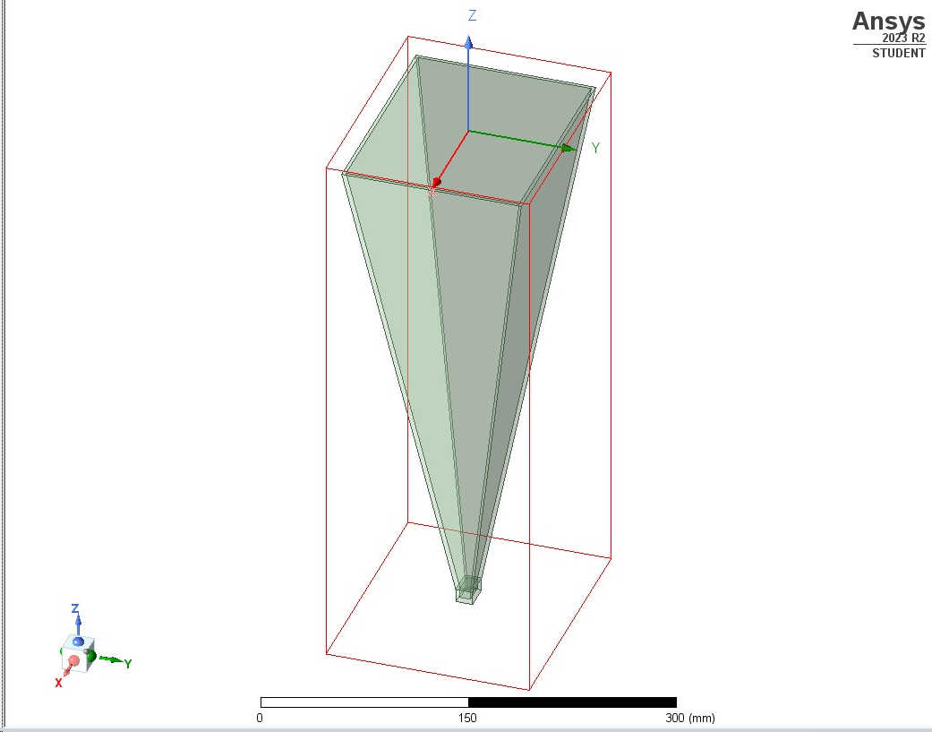
Horn Antenna fed by WR-62 Waveguide

Slide 3
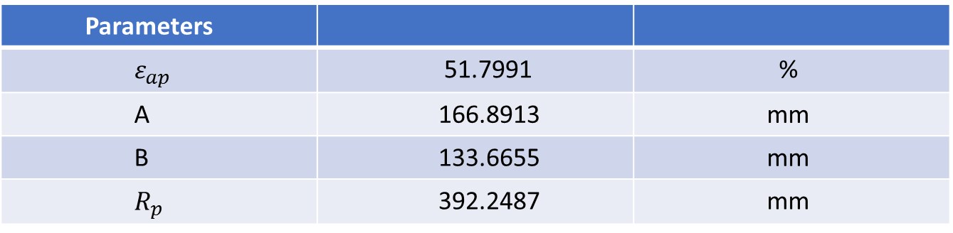
Table 1 Design Parameters
Parameters
$ε_{ap}$ | 51.7991 | %
A | 166.8913 | mm
B | 133.6655 | mm
$R_{p}$ | 392.2487 | mm

Slide 4
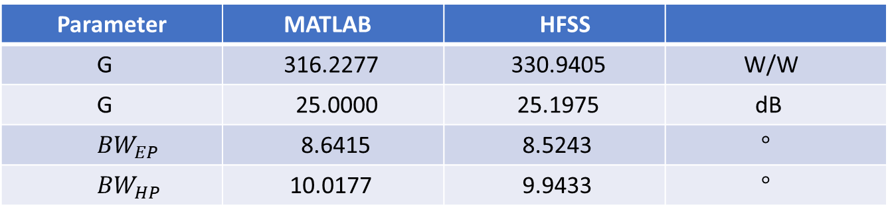
Table 2 Summary at 14 GHz
Parameter | MATLAB | HFSS
G | 316.2277 | 330.9405 | W/W
G | 25.0000 | 25.1975 | dB
${BW}_{EP}$ | 8.6415 | 8.5243 | $°$
${BW}_{HP}$ | 10.0177 | 9.9433 | $°$

Slide 5
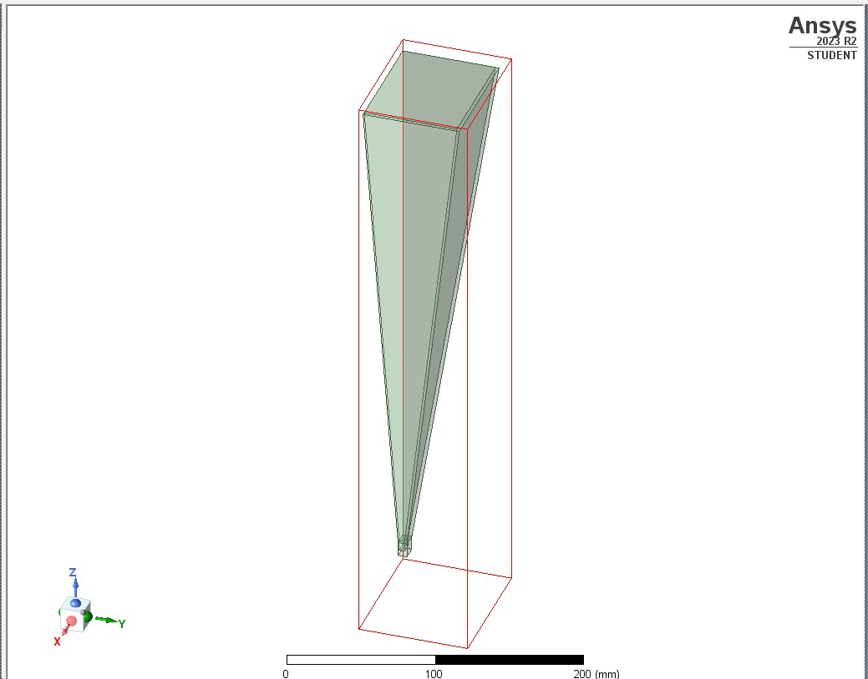
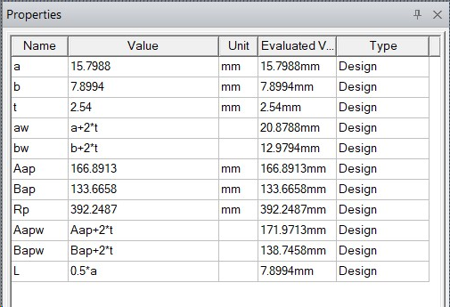

Slide 6
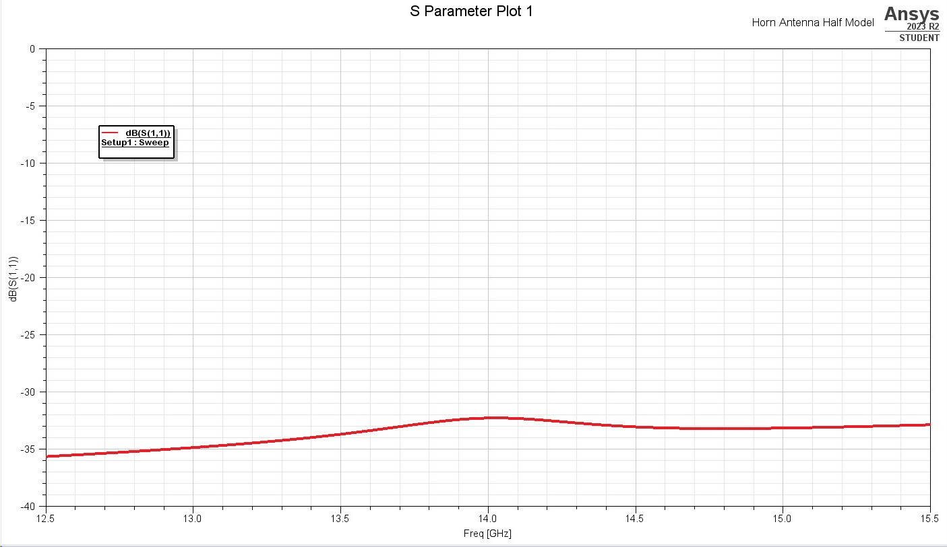

Slide 7
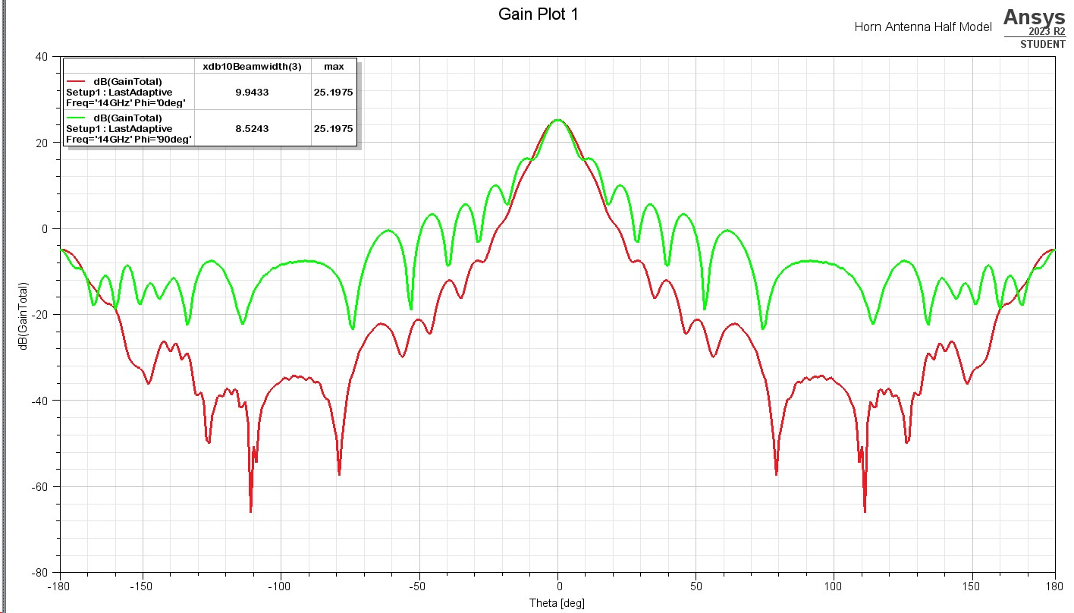

Slide 8
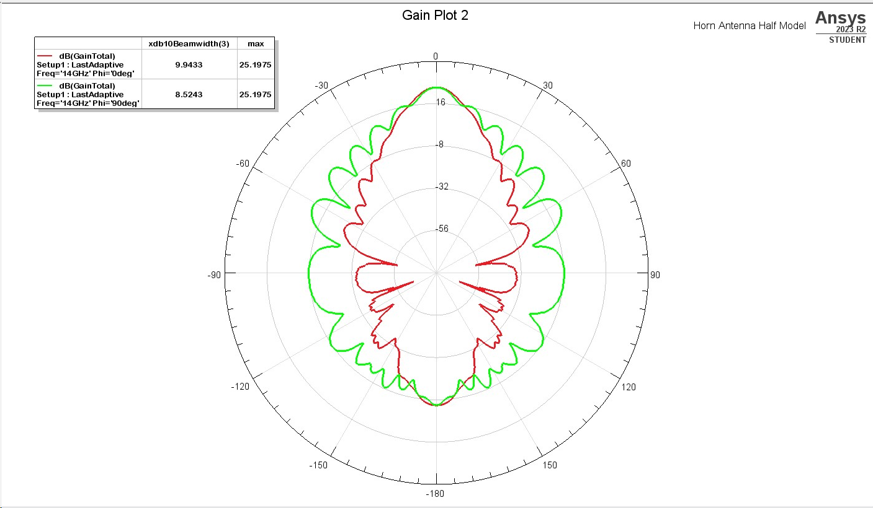

Slide 9
Appendices
HFSS
Matlab

Slide 10
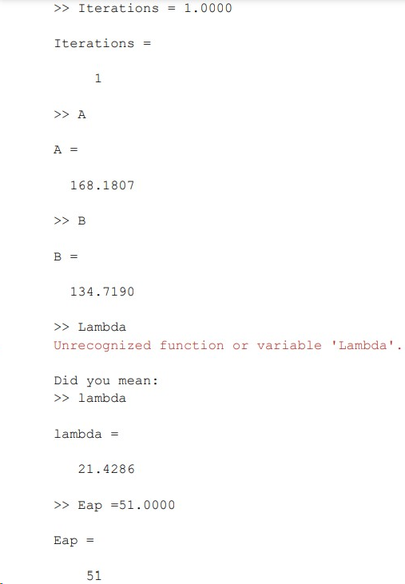
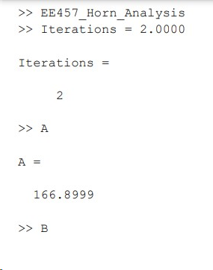
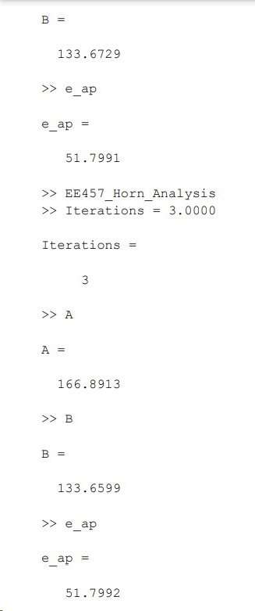
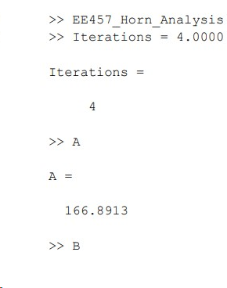
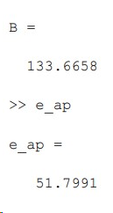









Slide 11
